Slide 1

Resume Workshop
Presented by:
Eric Hilden, Career Placement Officer
Saddleback College
(949) 582-4278
ehilden@saddleback.edu

Slide 2

Workshop Topics
General Guidelines
Preliminary Research
Heading
Objective Statement
Education
Employment Experience
References
Chronological Style
Functional Style
Combination Style

Slide 3
What is a resume?
A resume is a summary of your experience, ability, and accomplishments.
A resume is not a list of everything you’ve done in previous positions.
A resume must show your
VALUE to the new employer

Slide 4
Purpose of a resume?
A: Get a job?
B: Create referrals?
C: Generate curiosity?
D: Generate a job interview?
1: A? 4: B?
2: A & B? 5: C?
3: B & D? 6: D?

Slide 5


How long do you have to really impress?
6 Seconds!

Slide 6
General Guidelines
Length: It is best to limit an entry-level resume to one typed page. Be as concise as possible in stating information in each section of your resume.
Font: Avoid fonts smaller than 10 point and larger than 12 point.
Standard margins are 1” around the page
(it’s acceptable at times to go lower)
Use borders and bullets, but don’t to overdo it!
Be creative if you’re in a creative field. If you’re not, be careful
Layout / styles: There are plenty of templates out there. If it quickly conveys your value, use it! 1 column or 2 column

Slide 7
Preliminary Research
Find Out…
* General job information
* Desired qualifications and skills
* Key values and keywords that company uses
* Company Mission Statement, etc.
Where to look…
* Online: Websites, Blogs, Facebook, Snapchat?
* Professors
* Company literature
* LinkedIn!!!

Slide 8
Identifying Information
Your Name Should Stand Out!
Put your name, permanent and campus addresses, permanent and campus phone numbers, and email address prominently at the top of your resume.
Avoid using a nickname to identify yourself.
Consider including your URL address or fax number if you have one.
No casual emails or phone messages!
KIMBERLY ANN HURST
22333 Calle Vista Ave #112
Mission Viejo, CA
(949) 336-4432
What’s missing?
Always add a professional email to your resume!
LinkedIn URL? Your own website?

Slide 9
Objective Statement
Speak directly to the company and job title. Yes, this may need to change with each job you apply to:
“To secure the position of Financial Advisor with A.G. Edwards”
This tells an employer you want to work for them in that position. It doesn’t show the employer that you’re searching around, but rather that you’re focused and clear about your goals.

Slide 10
Summary of
Qualifications Statement
Consider what are the 4-5 key accomplishments, skills, abilities that highlight your VALUE!
Start with general statements of your overall skills.
Add soft skills for variety (Organized, Team-oriented, Effective managing projects, etc.)

Slide 11
Summary of
Qualifications Section
Example:
Summary of Qualifications
2 years professional experience in consumer sales in a variety of industries.
Proven ability to coordinate and complete multiple projects within deadlines.
Skilled at developing and retaining partnerships with clients and customers.
Driven, dedicated, and effective team player.

Slide 12
Professional Experience
Include positions you have held which are related, in some way, to the job you are seeking. These might be both paid and volunteer positions.
Be creative – people don’t want to read a cut/paste job description!
Think of what you ACCOMPLISHED – what is the good stuff that helps me determine that you’re a quality candidate?

Slide 13
Professional Experience
(sample)
BANQUET SERVICES INTERN May 2017 - August 2018
Holiday Inn, Laguna Hills, CA
Provided assistance across planning, set-up, and delivery of events including
25 – 350 in attendance for this three-star multi-service hotel and banquet facility.
*Assisted with the set-up of 5 – 20 six foot long tables including location and all tableware placement.
*Responded quickly and effectively to customer questions offering solutions and options as needed to maintain customer experience at high levels.
*Created a positive and healthy atmosphere within the banquet facility including excellent team-centered support to co-workers.
Make this content easy to read by using spacing and bullets
Use action phrases to highlight the duties you have performed.

Slide 14
Activities, honors, community involvement
Include relevant activities and honors that you could discuss with your prospective employer or that have given you valuable experience or skills.

Slide 15
Other Content to Add?
Computer / Technical Skills
Veteran
Community Involvement / Leadership
Languages

Slide 16
BASIC REMINDERS
AND QUESTIONS
SPELLING AND GRAMMAR COUNT!
IS YOUR RESUME EASY TO READ?
IS YOUR RESUME 1PAGE?
DOES YOUR RESUME INCLUDE KEYWORDS FROM THE JOB DESCRIPTION?
DOES YOUR RESUME REALLY MARKET YOUR
SKILLS, ABILITITES, KNOWLEDGE?

Slide 17
Resume Styles
Most common resume styles:
Chronological
Functional
Combination
Newer styles include:
  Website resumes
  Video resumes
  And other creative styles

Slide 18
Chronological Resume
Presents your education and work experience in chronological order, beginning with your most recent experiences.
Sample
Positives:
  Good if you have a long work history in one industry.
  Shows your strength in the industry
Negatives:
  Doesn’t really show how your skills match what they’re looking for.

Slide 19
Functional Resume
Organize experience by type of function performed. Under each, give specific examples.
Highlight experiences that directly relate to the job you are seeking.
Sample
Positives:
  Allows you to pull from all your experiences the skills each employer is looking for
  Tells the employer what you ‘can do’ versus ‘what you’ve done’
Negatives:
  Employers may ask the question: “Great, but tell me what you did in your jobs.”

Slide 20
What skills do you bring?
Transferable skills are found in how you did what you did. We use them in various situations and environments to do the things we like to do.
Skills are often hidden in the Job Description.
Skills can be found in resources like the O*Net and O.O.H.
Where to look for skills?
Consider your experiences and accomplishments in:
Previous Jobs
Volunteer experience
Class Projects
Even Hobbies/Interests

Slide 21
Writing skill statements
Remember the STAR method in writing these statements:
S…Describe the Situation
T…Describe the Task you were working on
A…Describe the Action you took
R…Describe the Result (Accomplishment)
Original:
Greeted customers providing excellent customer service
Revised with STAR:
Welcomed and greeted 30+ new customers per shift offering information on promotional items leading to increased sales and exceeding holiday sales quota.

Slide 22
Combination Style
Resume
As the name suggests, a blending of Functional and Chronological styles.
Allows flexibility to pull out some Key Skill Sets, while keeping a detailed list of Employment History.
Find Skill Sets by: Reviewing Job Announcements, Researching on the ONET, etc.
Sample

Slide 23
What are they really looking at?

Slide 24
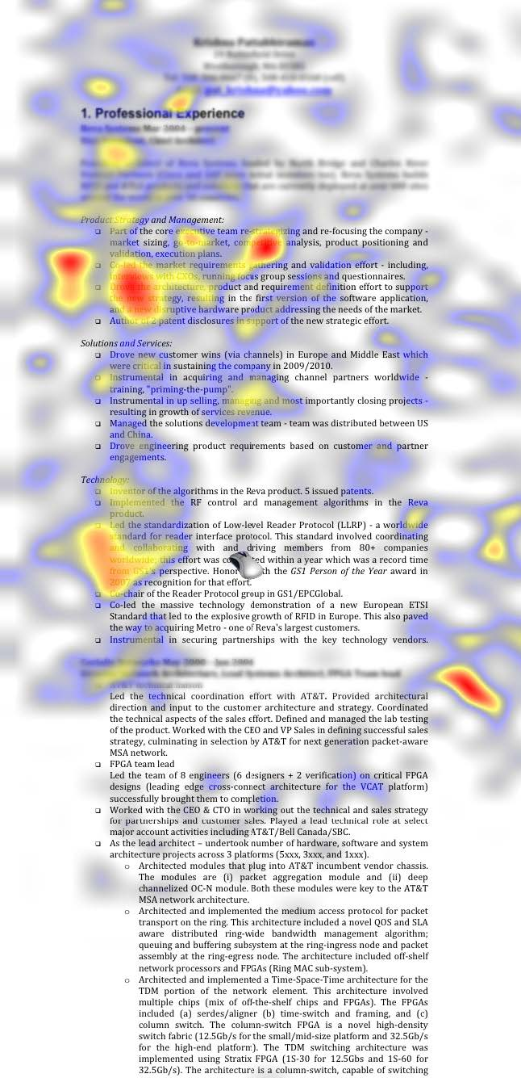

Slide 25
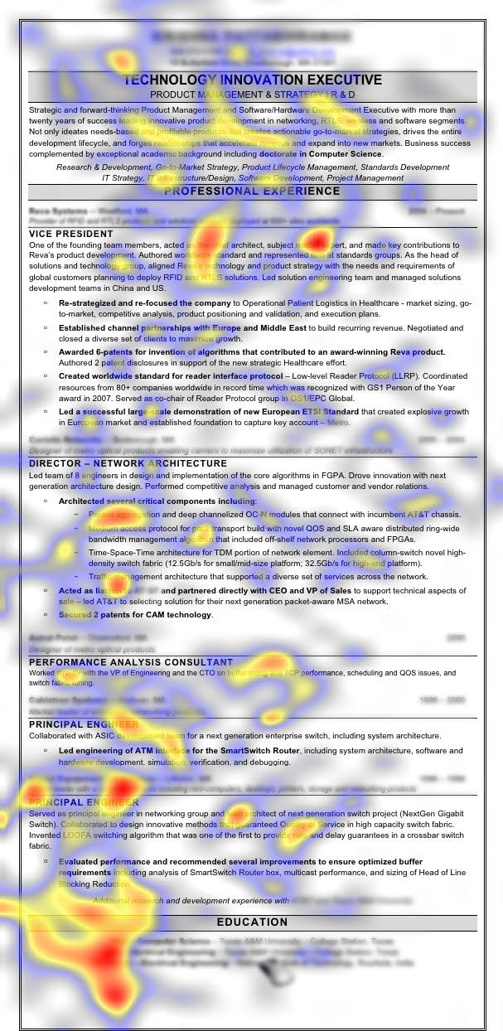

Slide 26
Reference Page
Do not include actual references on your resume
Create a separate page with your heading and title it:
REFERENCES
Include: Name, Title, Relationship to you, Company, Phone, Email and how you know the person!
Dr. Mary Smith, Business Department Faculty
Saddleback College
Mission Viejo, CA 92692
(949) 555-1212
msmith@saddleback.edu
Instructor for Business Communications and other business courses.
2. Mr. Smith, XXXXX…

Slide 27
Additional Resume Resources
Use the Resume Writing feature in the Student Employment System!
https://saddleback-csm.symplicity.com/students

Slide 28
Thanks!
Eric Hilden
Career Placement Officer
ehilden@saddleback.edu
www.saddleback.edu/jobs

